Slide 1

IT Infrastructure Management Chapter 7: Create, Delivery and Support (CDS) TY B.Sc. (IT)
Semester VI
Poornima .N
Assistant Professor, Department of IT/CS
1

Slide 2

3 Topics:
Service value system key concepts and challenges, Using a shift-left approach,
Plan and manage resources in the service value system,
The use and value of technology across the service value system

Slide 3

4 Introduction
Service Value System explains how ITIL ensures value creation through services. It shows how all components work together.

Slide 4
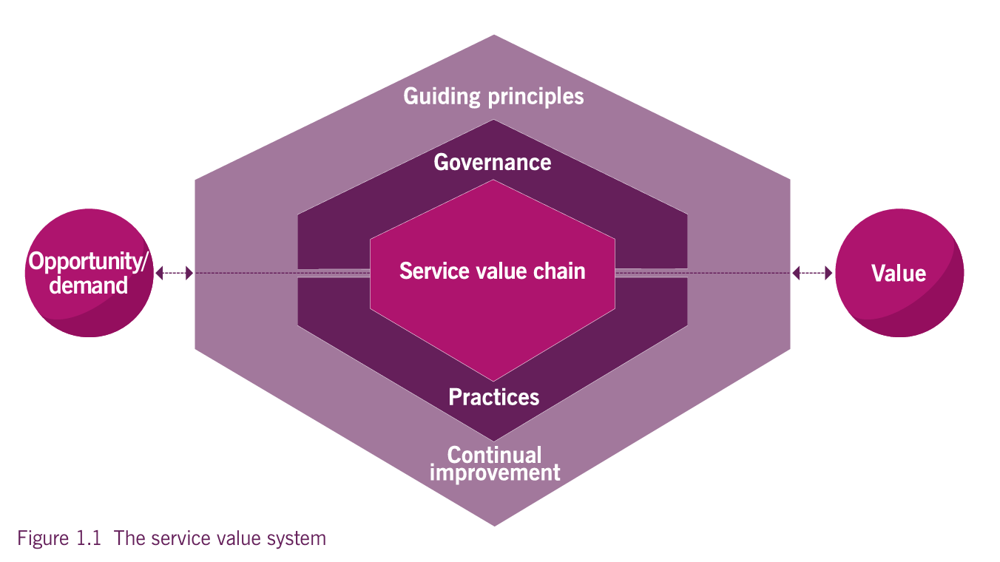
4 5 Components of SVS
Guiding Principles
Governance
Service Value Chain
Practices
Continual Improvement

Slide 5
5 CDS Connection
Design & Transition
Obtain/Build
Deliver & Support

Slide 6
6 Key Challenges in Create, Deliver & Support (CDS)
Organizational Silos
Balancing Speed vs Stability
Resource Constraints
Cultural Resistance
Technology Complexity

Slide 7
6 Shift-Left Approach
Shift-Left means moving activities like testing, security, and support earlier in the service lifecycle to detect and fix issues early.

Slide 8
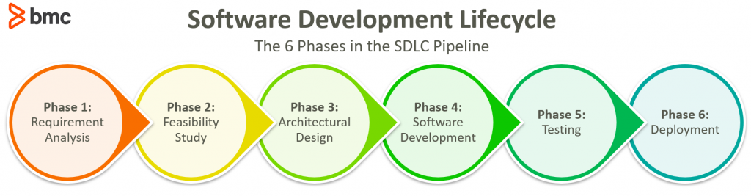

Slide 9
6 Types of Shift-Left
Testing Shift-Left
Security Shift-Left (DevSecOps)
Support Shift-Left

Slide 10
6 Testing Shift-Left
Testing during development
Automated testing
Continuous integration

Slide 11
6 Security Shift-Left (DevSecOps)
Security checks during design
Security integrated into development

Slide 12
6 Support Shift-Left
Knowledge base articles
Self-service portals
FAQs
Chatbots

Slide 13
6 Benefits
Reduced cost of fixing defects
Faster delivery
Improved quality
Fewer production failures
Better customer satisfaction

Slide 14
6 Challenges of Shift-Left
Need skilled teams
Requires automation tools
Cultural resistance
Initial investment

Slide 15
6 Role of Technology in Create, Deliver & Support (CDS)
Technology enables automation, monitoring, collaboration, and continuous improvement across the service value system.

Slide 16
6 1. Automation
CI/CD pipelines
Automated testing
Automated deployment
Infrastructure as Code (IaC)

Slide 17
6 2. Monitoring & Observability
Technology helps in:
Real-time monitoring
Event detection
Performance tracking
Alert systems

Slide 18
6 3. Cloud & Modern Platforms
Scalability
Flexibility
Faster provisioning
Cost control

Slide 19
6 AI & Analytics
Used for:
Predictive incident management
Chatbots
Trend analysis
Smart reporting

Slide 20
6 Value of Technology Across SVS
Technology supports all value chain activities:
Plan → Data analytics Design → Modeling tools Build → CI/CD tools Deliver → Monitoring systems Improve → Reports & metrics

Slide 21
6 Planning & Managing Resources in CDS
1️⃣ People 2️⃣ Information & Technology 3️⃣ Partners & Suppliers 4️⃣ Value Streams & Processes

Slide 22
6 1️⃣ Managing People
Skilled workforce is necessary
Cross-functional teams are preferred
Continuous learning is important

Slide 23
6 2️⃣ Managing Technology & Information
Includes:
Selecting correct tools
Maintaining systems
Managing data properly
Ensuring security

Slide 24
6 3️⃣ Managing Partners & Suppliers
Effective supplier management ensures service reliability.

Slide 25
6 4️⃣ Capacity & Workforce Planning
Value Stream: Steps taken to create and deliver a service.
Process: Structured set of activities.
Enough staff
Enough infrastructure
Enough budget
Not too much (waste) Not too little (overload)

Slide 26
6 Common Resource Challenges
Skill gaps
Budget constraints
Overworked teams
Dependency on vendors

Slide 27

Thank you…

